Slide 1

Office Move
Team Project 2 - Presented by Group C

Slide 2





Team Members
Andrea VanHorn
Vincent Mutungi
Rodrigo Balmaceda
Mohammed Rashed
Project Lead and Coordinator
Logistics and Scheduling Expert
IT Systems and Integration
Budget and Procurement Management

Slide 3




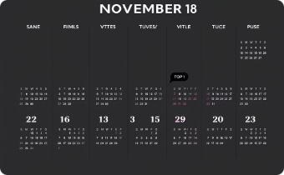
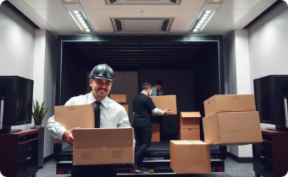

Project Overview
Move 70 employees and 3 executives by December 24, 2024
4-story building with 74 offices and 5 conference rooms
Complete setup including chairs, PCs, docking stations, and printers
Timeline spanning 23 workdays from Nov 18 to Dec 24
Concurrent furniture and IT teams working for efficiency
Budget of $153,350, including an approved increase

Slide 4

How We Solved It: Ensuring Success
Budget Management
1
Extended from $140K to $153,350 for full-spec setup
2
Crew Coordination
Appointed coordinator, daily briefings for concurrent tasks and hired 2 teams for each crews
Material Delays
3
Used $2K contingency, expedited deliveries in staged plan
4
IT Integration
Pre-testing and 2h debugging daily ensured smooth setup
Cost Overruns
5
Negotiated vendor cost splits, used contingency fund

Slide 5



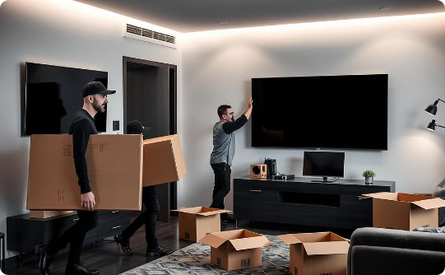
Project Schedule: Key Milestones
Initiation (Nov 18–20)
Planning (Nov 21–25)
Launch (Nov 26–Dec 24)
Building availability confirmed and contractors notified
Office assignments drafted and employees informed of move plans
Furniture installed, IT setup, and employee moves completed

Slide 6



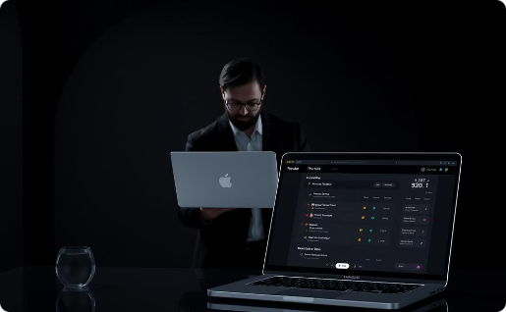
Constraints and Risks
Constraints
Risks
Mitigation
Initial budget $140K, raised to $153,350
Crew delay of 2 hours on Nov 27
Dedicated crew coordinator with daily briefings
Strict timeline: 23 workdays, no delays tolerated
Possible material delivery setbacks
IT failures such as docking station issues
$5K contingency fund available
Two furniture and two IT crews, 8-hour workdays, no overtime
Pre-testing of IT systems to prevent failures
Cost overruns on necessary repairs
Task dependencies critical for scheduling
Project tracking via Smartsheet software

Slide 7



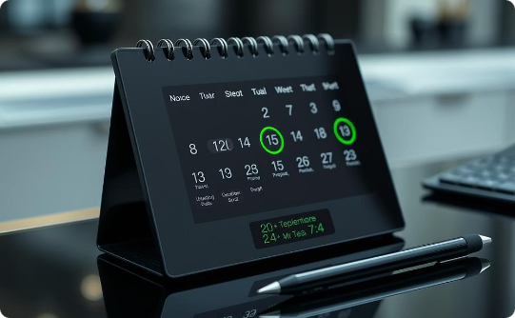
Lessons Learned
Successes
Challenges
Recommendations
Completed on time and within budget
Coordinated crew delays effectively
Plan 5% contingency budget
Smart use of contingency funds
Handled material delays with staged deliveries
Schedule deliveries outside holiday periods

Slide 8




Operational Impact & Feedback
Operational Impact
Stakeholder Feedback
Recognitions
Zero downtime; operations resumed promptly on 12/26/2024
Director praised timely delivery
Crew coordinator key to task completion
Division heads requested more pre-move updates
Marketing and Sales fully functional
IT lead swiftly resolved docking station issues
Achieved 90% employee satisfaction in survey
Suggested Q&A sessions before move

Slide 9


Thank You

